Slide 1

Problems on Conditional Probability

Slide 2
Reference
Data
Youtube
Code

Slide 3

[2016]

Slide 4




Slide 9
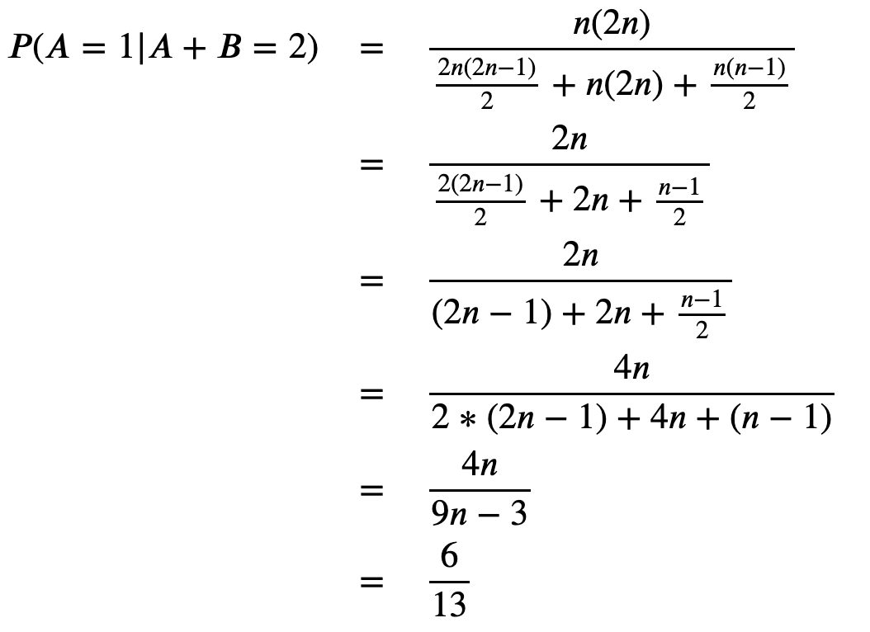

Slide 11


Slide 12


